Slide 1
Capstone Engagement
Assessment, Analysis, and Hardening of a Vulnerable System
Prepared By: Tamantha Boychuk, April 25, 2022
Tamantha Boychuk April 2022

Slide 2
Table of Contents
This document contains the following sections:
01
Network Topology
02
Red Team: Security Assessment
03
Blue Team: Log Analysis and Attack Characterization
04
Hardening: Proposed Alarms and Mitigation Strategies
Hardening: Proposed Alarms and Mitigation Strategies
Tamantha Boychuk April 2022

Slide 3
Network Topology
‹#›

Slide 4
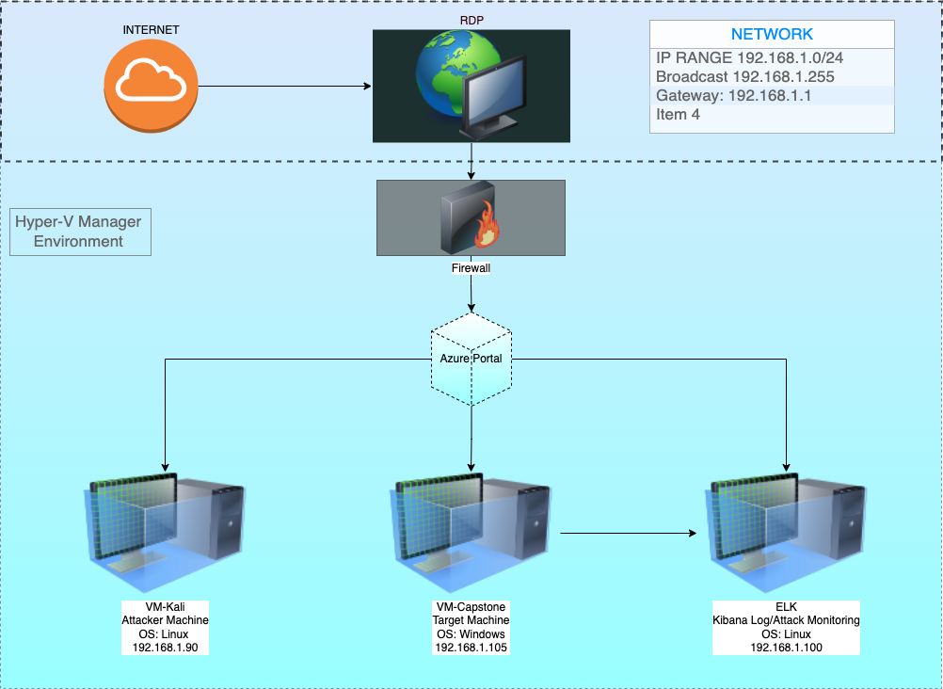
Network Topology
Network
Range:192.168.1.0/24
Broadcast: 192.168.1.255
Gateway: 192.168.1.1
Machines
Attacker 192.168.1.90
OS:Linux
Hostname:Kali
Target 192.168.1.105
OS:Linux
Hostname:Capstone
RDP 192.168.1.1
OS: MAC OS
Hostname:Remote Desktop
Kibana 192.168.1.100
OS:Linux
Hostname:ELK
Tamantha Boychuk April 2022

Slide 5

Red Team
Security Assessment
Tamantha Boychuk April 2022
‹#›

Slide 6
Recon: Describing the Target
Nmap identified the following hosts on the network:
Hostname | IP Address | Role on Network
Kali | Source.ip 192.168.1.90 | Kali was used as the attack machine.
Capstone | Destination.ip 192.168.1.105 | Capstone was the target machine.
ELK | 192.168.1.100 | ELK machine used to collect, process and send data to be analyzed later in Kibana.
Hyper-V-Manager | 192.168.1.1 | Is the jump box for Kali, Capstone and ELK.
Tamantha Boychuk April 2022

Slide 7
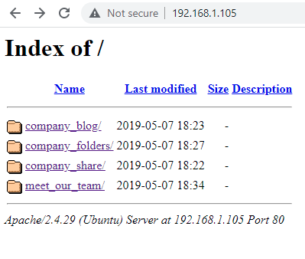
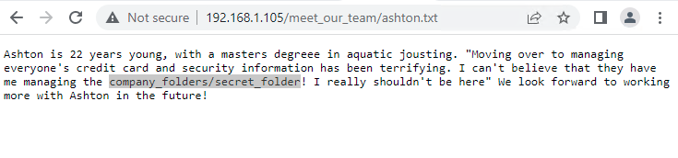
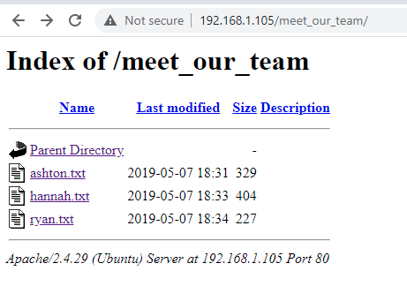
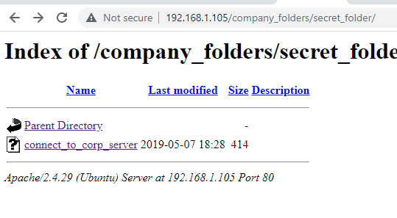
IP Address Exploration Results
Tamantha Boychuk April 2022

Slide 8
Exploitation: Hydra Brute Force Attack
01
02
03
Tools & Processes
Used Hydra to perform a dictionary attack to retrieve credentials of existing users to include usernames and passwords.
Ashton was being targeted specifically for his access to the companies “secret folder.”
Achievements
The brute force attack was successful in retrieving and matching password to Ashton. Gained access to secret_folder which led to another folder named connect_to_corp_server where a note regarding how to access the companies WebDAV server was found.
Exploit Command:
Hydra -l ashton -P /usr/share/wordlists/rockyou.txt -s 80 -vV 192.168.1.105 http-get /company_folders/secret_folder
-l = single user name
-P= list of passwords
-s= Port number
=vV= Verbose/show login+pw combination for each attempt
Tamantha Boychuk April 2022 Clickable Hyperlinks Highlighted & Underlined In Blue

Slide 9
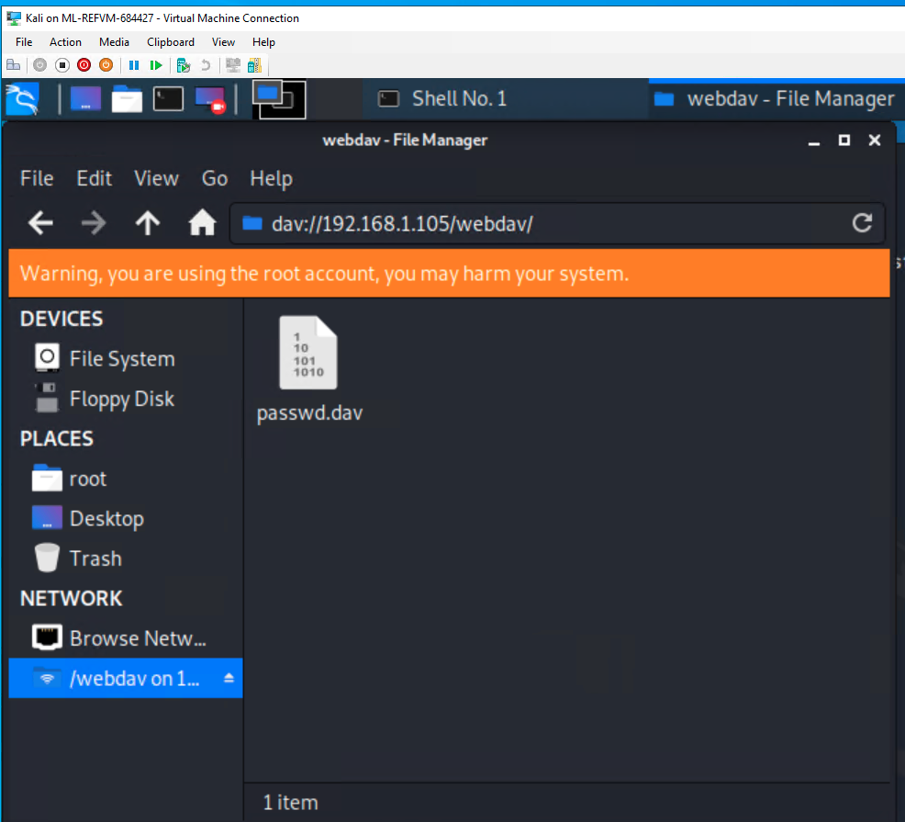
Exploitation: WebDAV Connection Exploit
01
02
03
Tools & Processes
A hash was discovered for employee named Ryan in Ashtons personal notes. Along with this information was also the discovery of a WebDAV connection.
Crackstation was used to decrypt Ryan’s hash in attempt to access files in the WebDAV connection folder.
Achievements
The hash was successfully decrypted using Crackstation.
In turn Ryan’s username and password did successfully access the WebDAV connection.
the exploit.]
Tamantha Boychuk April 2022 Clickable Hyperlinks Highlighted & Underlined In Blue

Slide 10
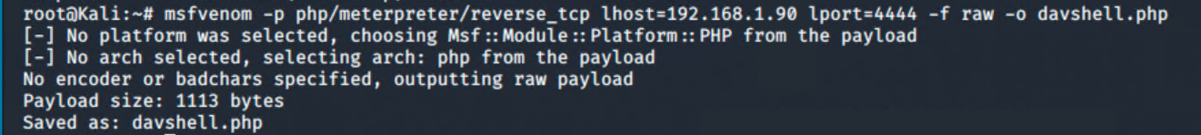
Exploitation: PHP Meterpreter Reverse Shell Payload
Tools & Processes
Metasploit was used to search php/meterpreter payloads.
A script was written and delivered via MSFVenom to establish a php reverse shell.
Achievements
Was successful using Metasploit to find a PHP Meterpreter payload.
php/meterpreter/reverse_tcp
Payload was successfully delivered using MSFVenom.
Successfully established a meterpreter session in target machine.
01
02
03
Tamantha Boychuk April 2022 Clickable Hyperlinks Highlighted & Underlined In Blue

Slide 11
Vulnerability Assessment
The assessment uncovered the following critical vulnerabilities in the target:
Vulnerability | Description | Impact
CVE-2020-14494 / CWE-307 | Authentication mechanism in the system does not provide sufficient complexity to protect against brute force attacks. | Can result in an attacker being able to discover multiple username/password combinations to gain access sensitive data on a system.
CVE-2017-7269 PROPFIND Request Exploit through WEBDAV service. | Bounds of the memory buffer are handled improperly making it possible for attacker to gain user rights. | This zero day exploit can result in catastrophic failure of confidentiality, integrity and availability of a system.
PHP Meterpreter Reverse_TCP Vulnerability CVE-2019-13386 (References reverse shell access with user privilege.) | This is a reverse shell payload used to gain meterpreter access to a compromised system through remote file injection. (RFI). | The severity of RFI attack can range from outputting the contents of a file to arbitrary code execution. In this case it allowed remote access in root to the affected server.
Tamantha Boychuk April 2022 Clickable Hyperlinks Highlighted & Underlined In Blue

Slide 12

Blue Team
Log Analysis and Attack Characterization
‹#›

Slide 13

Analysis: Identifying the Port Scan
Answer the following questions in bullet points under the screenshot if space allows. Otherwise, add the answers to speaker notes.
What time did the port scan occur?
How many packets were sent, and from which IP?
What indicates that this was a port scan?
[Insert Here]
Include a screenshot of Kibana logs depicting the port scan.
Tamantha Boychuk April 2022

Slide 14
Analysis: Finding the Request for the Hidden Directory
Answer the following questions in bullet points under the screenshot if space allows. Otherwise, add the answers to speaker notes.
What time did the request occur? How many requests were made?
Which files were requested? What did they contain?
[Insert Here]
Include a screenshot of Kibana logs depicting the request for the hidden directory.
Tamantha Boychuk April 2022

Slide 15
Analysis: Uncovering the Brute Force Attack
Answer the following questions in bullet points under the screenshot if space allows. Otherwise, add the answers to speaker notes.
How many requests were made in the attack?
How many requests had been made before the attacker discovered the password?
[Insert Here]
Include a screenshot of Kibana logs depicting the brute force attack.
Tamantha Boychuk April 2022

Slide 16
Analysis: Finding the WebDAV Connection
Answer the following questions in bullet points under the screenshot if space allows. Otherwise, add the answers to speaker notes.
How many requests were made to this directory?
Which files were requested?
[Insert Here]
Add a screenshot of Kibana logs depicting the WebDAV connection.
Tamantha Boychuk April 2022

Slide 17

Blue Team
Proposed Alarms and Mitigation Strategies
‹#›

Slide 18
Mitigation: Blocking the Port Scan
What kind of alarm can be set to detect future port scans?
What threshold would you set to activate this alarm?
What configurations can be set on the host to mitigate port scans?
Describe the solution. If possible, provide required command lines.
Tamantha Boychuk April 2022

Slide 19
Mitigation: Finding the Request for the Hidden Directory
What kind of alarm can be set to detect future unauthorized access?
What threshold would you set to activate this alarm?
What configuration can be set on the host to block unwanted access?
Describe the solution. If possible, provide required command lines.
Tamantha Boychuk April 2022

Slide 20
Mitigation: Preventing Brute Force Attacks
What kind of alarm can be set to detect future brute force attacks?
What threshold would you set to activate this alarm?
What configuration can be set on the host to block brute force attacks?
Describe the solution. If possible, provide the required command line(s).
Tamantha Boychuk April 2022

Slide 21
Mitigation: Detecting the WebDAV Connection
What kind of alarm can be set to detect future access to this directory?
What threshold would you set to activate this alarm?
What configuration can be set on the host to control access?
Describe the solution. If possible, provide the required command line(s).
Tamantha Boychuk April 2022

Slide 22
Mitigation: Identifying Reverse Shell Uploads
What kind of alarm can be set to detect future file uploads?
What threshold would you set to activate this alarm?
What configuration can be set on the host to block file uploads?
Describe the solution. If possible, provide the required command line.
Tamantha Boychuk April 2022

